Slide 1
Artificial Intelligence & Machine Learning
SlideMake.com

Slide 2
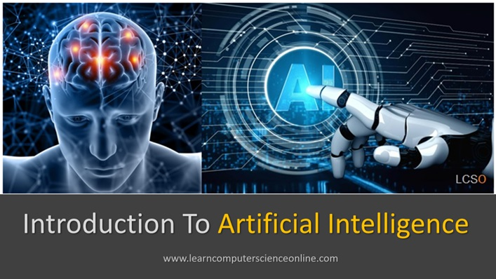
Introduction to Artificial Intelligence
Artificial Intelligence (AI) refers to the simulation of human intelligence processes by machines, especially computer systems.
AI encompasses a variety of technologies designed to perform tasks that typically require human cognition.
The field of AI has evolved significantly, impacting numerous industries and daily life.
Notes:
Image source: https://www.learncomputerscienceonline.com

Slide 3
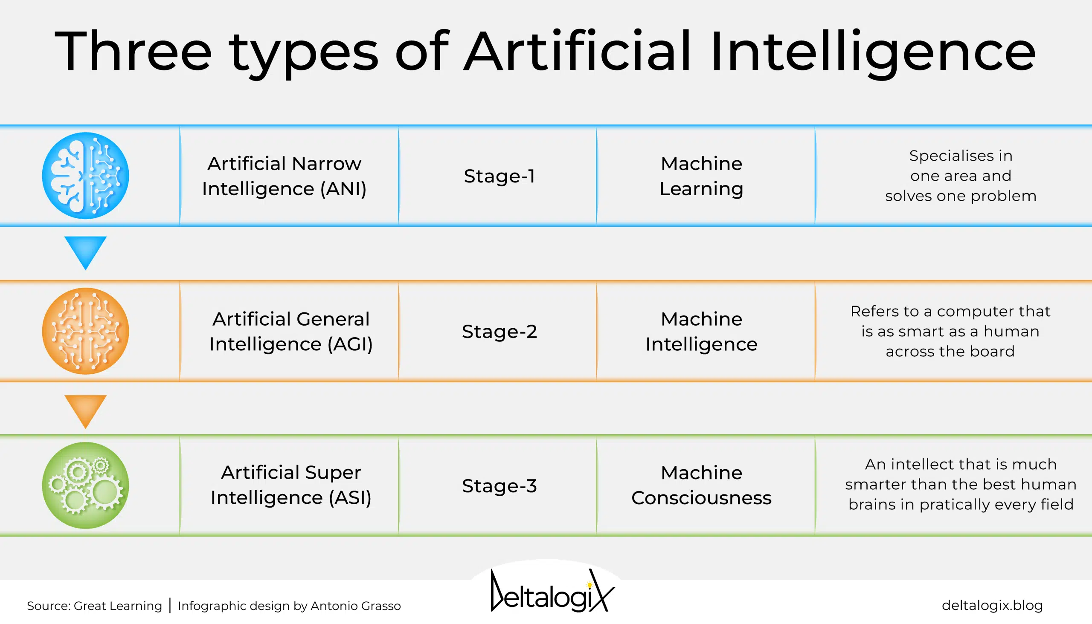
Types of Artificial Intelligence
Narrow AI, also known as weak AI, is designed to perform specific tasks and is prevalent today.
General AI, or strong AI, would possess the ability to understand, learn, and apply intelligence across a wide range of tasks.
Currently, most AI applications are based on narrow AI, with general AI remaining a theoretical goal.
Notes:
Image source: https://deltalogix.blog

Slide 4
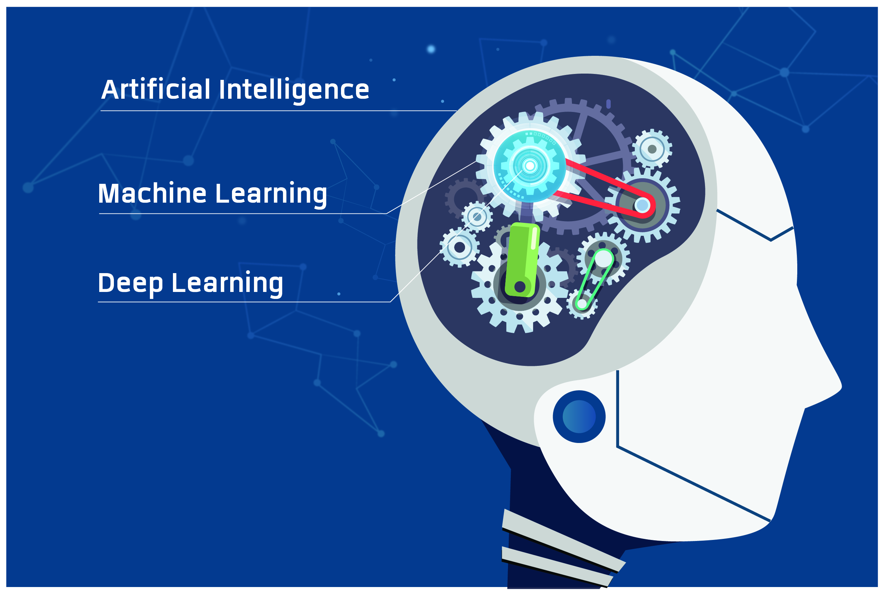
Machine Learning Overview
Machine Learning (ML) is a subset of AI that enables systems to learn from data and improve over time without being explicitly programmed.
ML algorithms identify patterns in data to make predictions or decisions.
Common types of ML include supervised learning, unsupervised learning, and reinforcement learning.
Notes:
Image source: https://storage.googleapis.com

Slide 5

Supervised, Unsupervised, and Reinforcement Learning
Supervised learning uses labeled data to train models for tasks like classification and regression.
Unsupervised learning analyzes unlabeled data to discover hidden patterns or groupings.
Reinforcement learning teaches systems to make decisions through trial and error, receiving rewards or penalties.
Notes:
Image source: https://www.slidemake.com

Slide 6
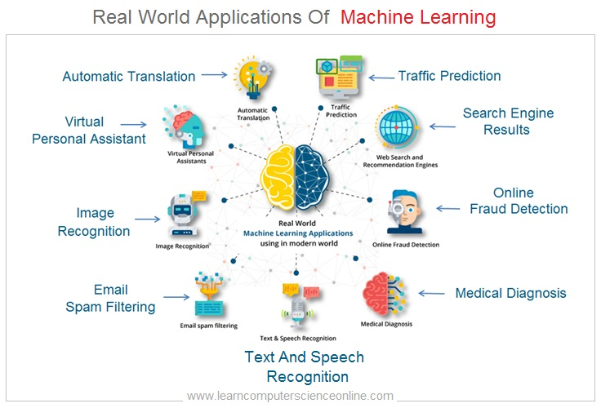
Applications of Artificial Intelligence
AI is widely used in healthcare for diagnostics, personalized medicine, and drug discovery.
In finance, AI powers algorithms for trading, fraud detection, and customer service.
Other applications include autonomous vehicles, natural language processing, and recommendation systems.
Notes:
Image source: https://www.learncomputerscienceonline.com

Slide 7
Ethical Considerations and Challenges
AI raises ethical concerns related to privacy, bias, transparency, and job displacement.
Ensuring AI systems are fair and unbiased requires careful data selection and algorithm design.
Developing regulations and standards is crucial to mitigate risks associated with AI deployment.
Notes:
Image source: https://preview.redd.it

Slide 8
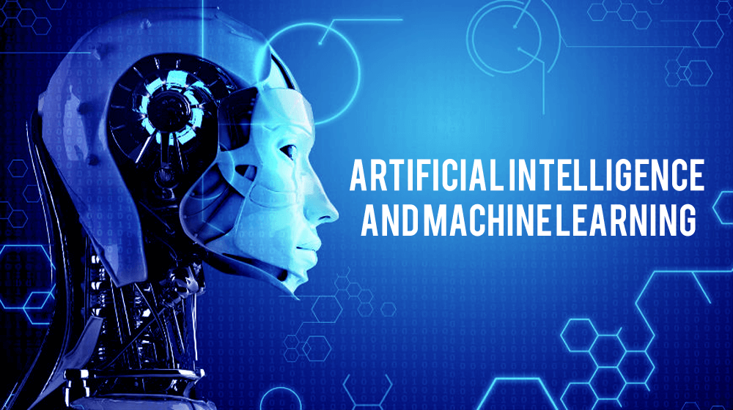
Future of AI and Machine Learning
Advancements in AI are expected to lead to more autonomous, intelligent systems capable of complex tasks.
Research is ongoing to develop explainable AI, making decision processes transparent and understandable.
Collaboration between humans and AI will likely enhance productivity and innovation across sectors.
Notes:
Image source: https://www.weetechsolution.com

Slide 9
References
Russell, S., & Norvig, P. (2020).
Artificial Intelligence: A Modern Approach
. Pearson.

